Slide 1
Job To Be Done based onClayton Christensen et.al. ”Competing Against Luck” (C. Chrisetensen, 2016)
Claus Rosenstand
U-CrAc 2018
Notes:
2005: First paper on JTBD Theory
1995: Innovators’ dilemma – inbumbent / entrant’
Theory of disruption offer why disruption happens; but does not offer a causal explanation of what a company should do to become successful

Slide 2
Innovation
Progress !
(Not products)
Why costumers make the choices they do?
Notes:
Costumers pull products into their lives to make progress
Quantitative data allows managers to sleep at night.
E.g. Driver license: Correlation is not the same as causality
Data focused around customers and the product itself – not how well the product is solving customers’ progress
-> Vanity performance metrics (not helpful to innovation) – e.g. numbers of teaching hours (when learning…)!

Slide 3
Keep your eye on the JTBD
Three pitfalls
Active (loud) versus passive (quiet) data
Product sales => Product
Customers’ purchase => Customer
Competitor’s emerge => Benchmark
Investment in
People => productivity data
Facilities => Returns
Technology => Value
Surface growth
Conforming data
Notes:
Active versus passive data: Remember: Data is man-made -> Managing numbers instead of JTBD (Few deep interviews / observations)
Surface growth: Creating many products for many customers – loos focus on JTBD (vulnerable to disrupters focusing on one job)
Conforming data: All departments brings data supporting their arguments – but non of them tells you why, the customer purchase your product.
(Confirm that the customers wants to buy the products that the managers want to sell)
There is no single truth
Active data is directionally helpful; but it is not objective.

Slide 4
The Milkshake Example
https://www.youtube.com/watch?v=Q63PZR7mG70

Slide 5
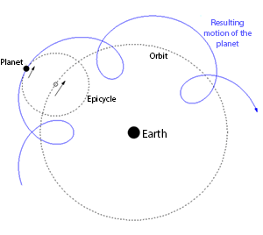
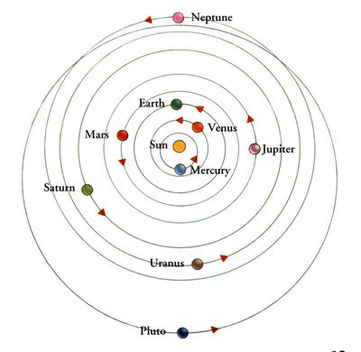
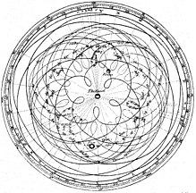
epicycles
Jobs specs are blueprints that translate
richness and complexity of jobs into an actionable guide for innovation
Notes:
Before and after Copernicus
Customer versus JTBD in centrum
Small difference – but changes everything – paradigm shift: Lenses to see differently at things everybody else is looking at.
E.g. ”Construction of homes” versus ”business of moving lives”
E.g. ”Education” versus ”Life engaging project - self realization”
If we only think of product performance, we are likely to miss the real issue

Slide 6
Job Metaphor
What job did you hire X to do?
What causes our customer to purchase X?
Provide a solution in a market,
where complication and high cost
have become status quo
How do your case-partner as a
successful organization know how to be successfull?
Notes:
If no good solution to a job: ”Cheaper and crappier” is better than nothing
Job: Progress (movement) that a person is trying to make in a particular circumstance – e.g. small / big organization – global / local – production / consulting?
JTBD are ongoing and recurring

Slide 7
How (Not What) to Think!
Satisfying a Job is not just creating a product, but engineering a whole set of experiences integrated in your case-partners processes and culture – almost impossible to copy
We do not create jobs, we discover them!
(In the context of a specific consumer struggle)
Functional, social, and emotional dimensions
How we solve the job should change over time
Notes:
Good theory – helps to get to the right answers.
More specific than needs (do not explain why I choose)
Deep understanding of customer – through observation and dialog. See the same as others; however, with a new perspective.
Managers like to keep framing of competition simple (constrains innovation) -> market zero-sum game
New or improved products succeed because of the experience they provide (not because of features)
Cost or efficiency is not core elements of JTBD

Slide 8
Where are the jobs?
A job close to home
Competing against nothing
Workarounds and compensating behaviors
Look for what people don’t want to do
Unusual uses
Notes:
Close to home: Entrepreneur both customer and provider. E.g Limfjordsbroenl
Competing against nothing: no satisfying solution – non-consumption (most fertile opportunities) – E.g. Front-Sale – Cloth are wasted!
Workarounds: GeoGuide (have to find information in another way)
Don’t want to do: E.g. Go to duty doctor. TrackUnit – Machinery up-time
Unusual uses: Uses your product in an un-envisioned way. E.g. Juice for eating vegetables… - GeoGuide-case
You need a beginner’s mind as you walk through a consumer’s decision-making process (be surprised)

Slide 9
The overrated customer
Motivations and pathway to purchase are more complex than customers can describe
Big Hire <> Little hire
What has to get fired to get X hired?
Customer change forces: New <> keeping
Notes:
Big Hire = When buying
Little Hire = When consuming
Change forces: New: frustration or problem must be substantial better. Keeping: habits and anxiety of the new
Avoiding loos is much more powerful than possible gains. Overcoming customer anxiety is a big deal.

Slide 10
purpose brand
Integrate around important JTBD
Synonyms with the job
Stop consumers for considering alternatives

